Slide 1
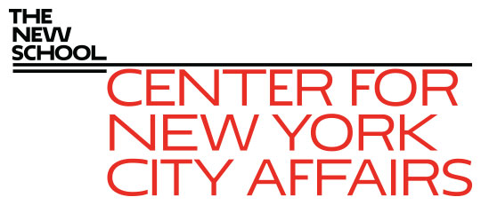
How Does the NYC Labor Market Recover from the Covid-19 Impact? James A. Parrott, PhD Center for New York City Affairs at The New School JamesParrott@newschool.edu www.centernyc.org Economic Research Roundtable June 29, 2021 Funding support provided by the Robin Hood Foundation, New York City Workforce Development Fund, New York Community Trust, JPMorgan Chase Foundation, 21st Century ILGWU Heritage Fund, and Consortium for Worker Education
James A. Parrott, PhD
Director of Economic and Fiscal Policies
Center for New York City Affairs
New School University
JamesParrott@newschool.edu

Slide 2
Overview
How is the Covid-19 economic dislocation different?
Which workers were affected?
How has the pandemic re-shaped the city’s economy and its jobs?
What has to happen for the NYC job market to recover?

Slide 3
How is the Covid-19 dislocation different than a business cycle downturn?
Business and job dislocations result from government-mandated restrictions to protect public health
Credit access problems and reduced consumer spending are not driving job losses
Different sectoral and labor impacts
Highly uneven economic and health impacts depending on sector, public health risks, and ability of high-income workers to work remotely
Need a new conceptual lens to analyze economic impacts

Slide 4
3 Covid Categories
Essential: health care, human services, public safety and services
Face-to-Face: restaurants, hotels, retail, arts, transportation, construction, building services, local services
Remote-working: finance and real estate, professional services, information

Slide 5
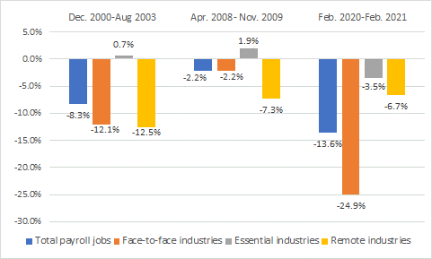
Pandemic’s distinctive pattern of NYC job losses

Slide 6
As of May, NYC jobs were 10.9% below Feb. 2020; nearly 3 times the national 3.7% drop

Slide 7
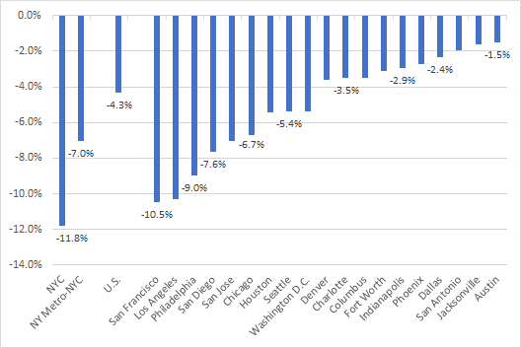
NYC job losses greatest among 20 largest U.S. cities Feb. 2020-Apr. 2021

Slide 8
As of May, NYC still down 510,000 payroll jobs since Feb. 2020; only 45% of lost jobs have been regained (vs. 74% in rest of the U.S.)

Slide 9
NYC loss of payroll jobs plus indep. contractor jobs averaged 748,000 per month Mar.-Dec. 2020

Slide 10
Workers of color are 75% of those losing jobs; chart below shows likelihood of losing job compared to the average

Slide 11
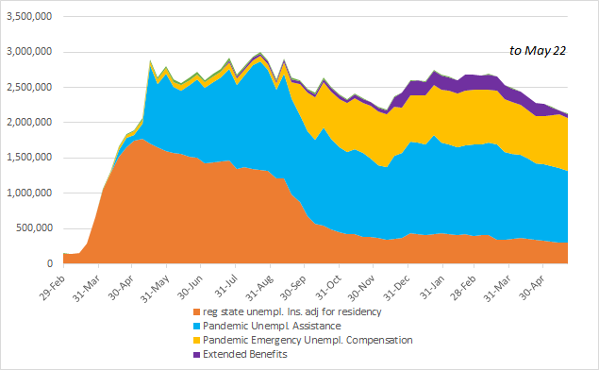
As of late-May, NYS continuing unemployment insurance claims were about 2.1 million, down by 600,000 since mid-January inflection; in 3 months, it will be about 300,000

Slide 14
Substantial adverse labor market impacts beyond the sheer extent of job losses
Record number of NYC long-term (26 wks. +) jobless; 500,000-600,000 based on UI data
Sharp rise in involuntary part-time employment
Parents, particularly women, kept out of labor force by care-giving and child-rearing responsibilities
Continuing concerns about health risks

Slide 15
Are unemployment benefits the reason some employers are having a hard time recruiting workers?
No simple answers in an unsettled job market
Record quit rates as well as openings, esp. in restaurants
Lack of affordable child care a huge challenge
Lingering concerns about unvaccinated persons
NYS’s partial unemployment system complicates assessing effects on benefits of PT work
Workers should be able to rethink their return-to-work and career options—the economy will be benefit in the long run

Slide 16
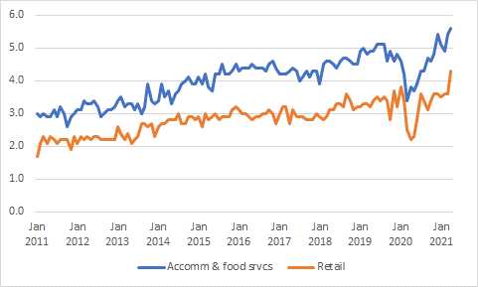
Surge in quit rates (national) in food services and retail

Slide 17
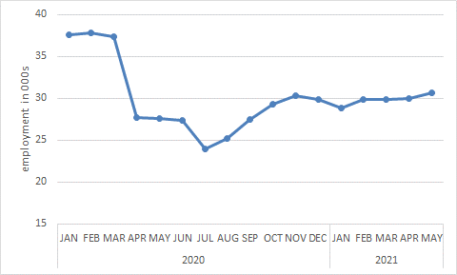
NYC child care employment is still nearly 20% below pre-pandemic levels

Slide 18
Astoria survey pointed up several challenges NYC workers face post-Covid
One-third of respondents were furloughed or laid off; another 35% lost hours and pay
More than ¾ of < $50k households lost jobs or pay
Freelancers had even higher rates of displacement than payroll workers (85% vs. 58%)
Only 38% of dislocated returned to work (only 1/3 full-time, 2/3 part-time)
Only 42% of dislocated expected to return to work with the same employer; 20% expected to have to find work in a new occupation or industry.

Slide 19
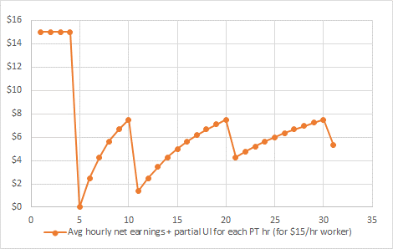
NYS workers returning to work part-time face “cliff effects” for partial benefits

Slide 20
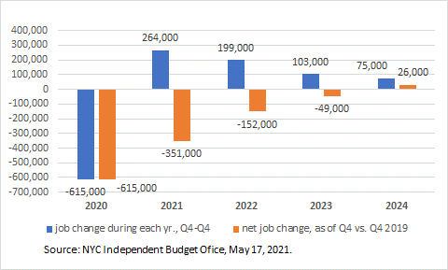
NYC Independent Budget Office projects Covid-19 jobs deficit will last until late 2024 (w/o accounting for changing mix)

Slide 21
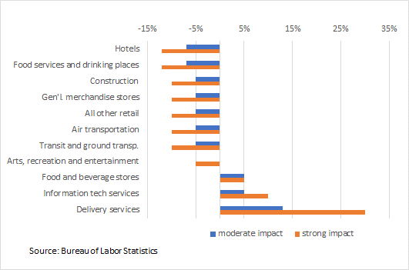
Percent change in U.S. demand (2019-29) vs. baseline BLS projection due to pandemic effects

Slide 22
Percent change in U.S. occupational demand (2019-2029) vs. baseline BLS proj. due to pandemic effects

Slide 23
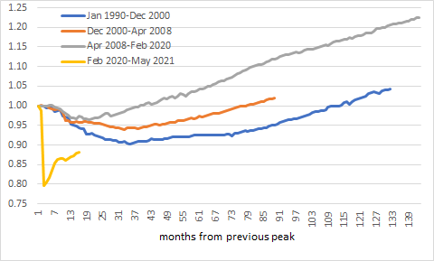
While the pandemic is different, for the last 3 downturns, it has taken NYC at least 38 months to reach the previous peak jobs level, and that was for a relatively small decline (vs. a 20% pandemic drop)

Slide 24
It usually takes several years for the NYC unemploy- ment rate to reach the previous cycle’s low

Slide 25
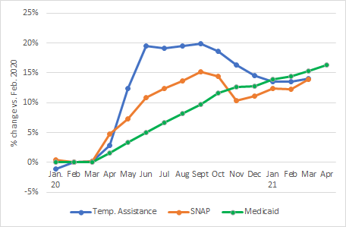
NYC public assistance rolls up 15% since last spring; Medicaid enrollments soared 520,000 since last Feb.

Slide 26
Key takeaways
Pandemic economic effects different than the impact of a business cycle downturn
Job displacement greater in NYC than U.S. or other large cities
Significant re-employment challenges due to long-term unemployed, slow recovery in hospitality and related, & acceleration of certain pre-pandemic trends
Greater labor market intervention in the form of workforce development assistance and expanded training are needed; otherwise, substantial economic gains by persons of color from 2013-19 at risk

Slide 27
Additional research needs
Who/where are the workers who need to be re-connected or re-skilled?
Is the NYC workforce “system” able to effectively respond?
What will the lingering effects be of long-term unemployment?
How has the Covid-19 economic impact affected public safety?
Will the spate of new businesses survive and grow; how do we assess the demise of many long-established businesses?

Slide 28
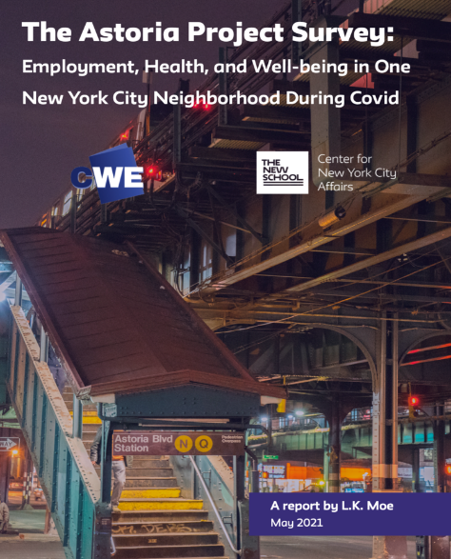
CNYCA’s Covid-19 Economic Recovery Project
http://www.centernyc.org/covid19-economic-impact for all reports, updates, news coverage, presentations
Bi-weekly Economic Updates in NYC Employment and Training Coalition’s Workforce Weekly and on the Center’s Covid-19 webpage
Recent Astoria report: http://www.centernyc.org/reports-briefs/2021/6/2/the-astoria-project-employment-health-and-well-being-in-one-new-york-city-neighborhood-during-covid

Slide 29
Thank you. James Parrott Center for New York City Affairs The New School ParrottJ@newschool.edu
www.CenterNYC.org

