Slide 1

Inequality and New York City
Economic Structure
June 12, 2019
James A. Parrott
Inequality by the Numbers
Fifth Annual Workshop, June 10-14, 2019
CUNY Grad Center
Stone Center on Socio-Economic Inequality
James A. Parrott, PhD
Director of Economic and Fiscal Policies
Center for New York City Affairs
New School University
ParrottJ@newschool.edu

Slide 2
The Center for New York City Affairs at The New School is an applied policy research organization that offers solutions to the most pressing social and economic challenges faced by New York communities. The Center conducts in-depth, timely research that informs public policy.
www.centernyc.org

Slide 3
1. Income inequality/polarization—reflection of how market-based economic forces mediated by government.
2. How polarized are NYC incomes; what are recent trends?
3. How has NYC’s economic structure changed since 1980 and how has that affected wages and incomes?
4. Current expansion’s dual character—wage and income gains, but persistent economic insecurity
5. How significant is the “gig economy” in NYC?
6. What can be done locally to address income inequality?
Overview

Slide 4
1. Income inequality/ polarization--reflection of market-based economic forces mediated by government

Slide 5
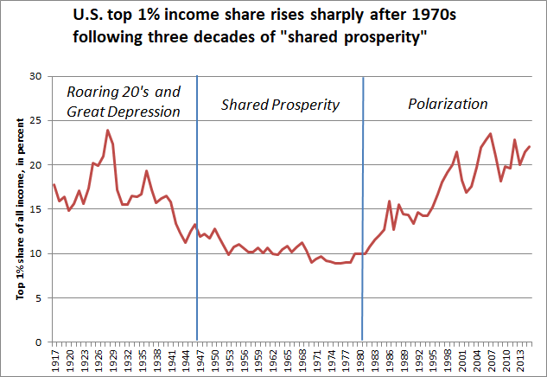

Slide 6
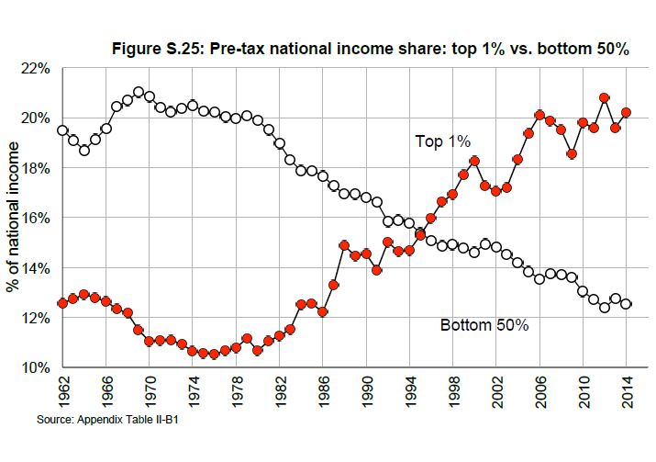
Income share of bottom 50% falls steadily after 1980
Source: Piketty, Saez and Zucman, Distributional National Accounts: Methods and Estimates for the
U.S., Data Appendix, Nov. 10, 2017.

Slide 7
Policy changes shaping U.S. and NYC economic changes post-1980
Financial deregulation
Globalization, increased foreign investment, not regulating trade
Letting barriers to unionization remain
“Policy drift” in not responding to “fissuring” of the workplace
Allowing the minimum wage to falter
Fostering economic competition among states

Slide 8
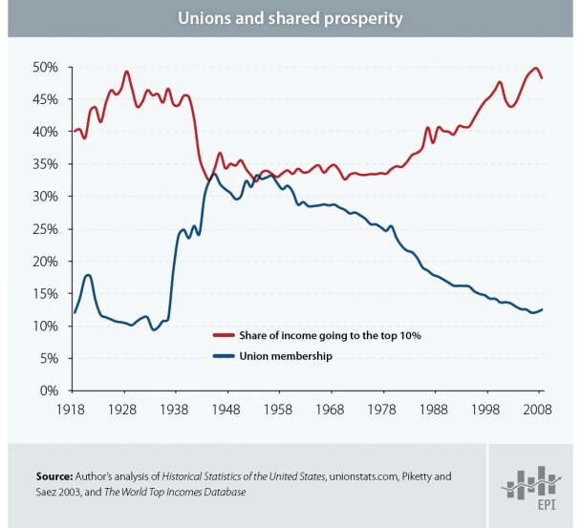
Labor unions had a lot to do with creating shared prosperity.

Slide 9
2. How polarized are NYC incomes and what are recent trends?

Slide 10
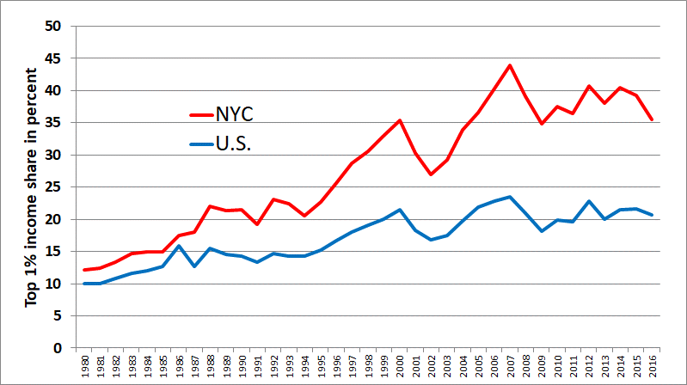
Income share of top 1% much greater in New York City than in the U.S.
1% share in NYC fell in 2015 due to capital gains decline, and in 2016 due to tax planning in anticipation of Trump tax cuts.

Slide 11
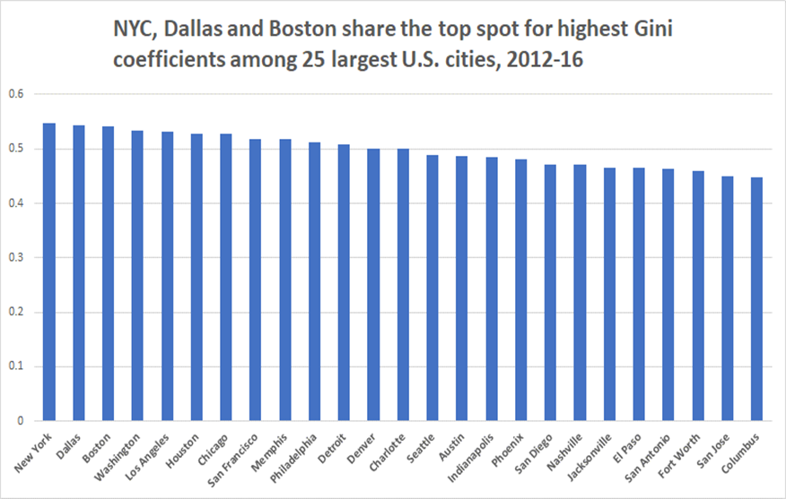

Slide 12
What accounts for NYC’s higher income concentration?
Large finance sector
Corporate HQ and professional services
Inherited and new wealth
Real estate

Slide 13
Income sources for NYC’s richest 1% in 2016
In 2016, wages were 36% of income for top 1%; capital gains and business income each about 25%, and dividends and interest were 12%.
Top 1% of NYC households had high shares of all forms of income:
  36% all income
  18% wage income
  70% dividends and interest
  71% business income
  86% realized capital gains

Slide 14
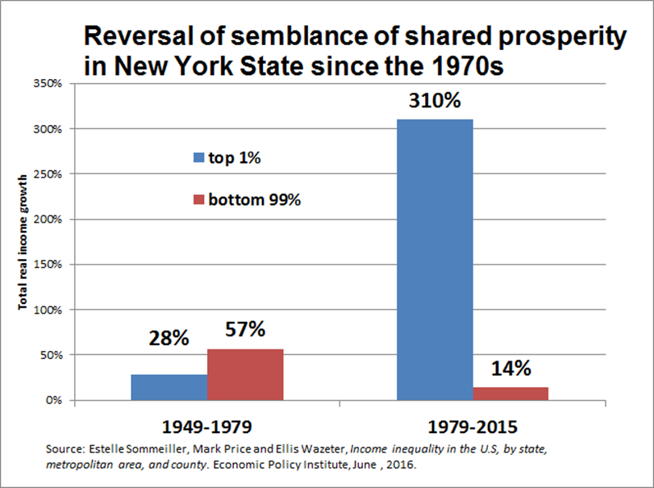

Slide 15
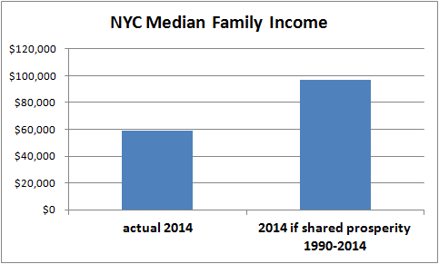
If NYC median family income had grown at the same pace as the increase in the city’s per capita gross city product, the 2014 level would have been about $97,000, about two-thirds higher than the 2014 actual.

Slide 16
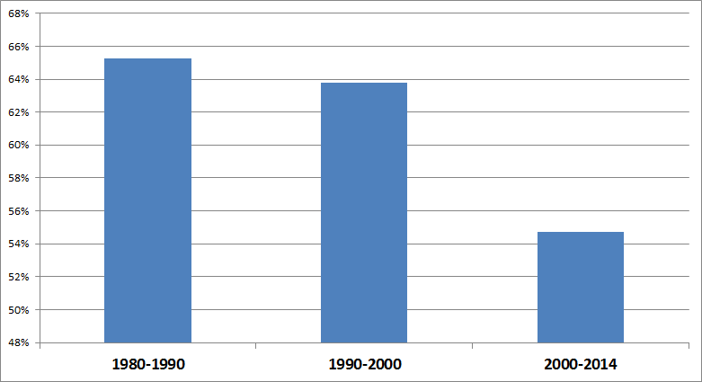
In 1980s & 1990s, NYC’s 1% claimed nearly 2/3 of total income growth; since 2000, 1% share has eased to 55%.

Slide 17
3. How has NYC’s economic structure changed since 1980 and how has that affected wages and incomes?

Slide 18
How did the structure of NYC’s economy change in the post-1980 era of income polarization?
For the bottom 95%, wages are 93% of all income--how did sector and occupational changes affect wages.
Then consider the policy developments (both action and inaction) that influenced particular forms of economic change.
This is a narrative headed toward discussing how local policy levers can be used to better respond to economic changes that exacerbate polarization.

Slide 19
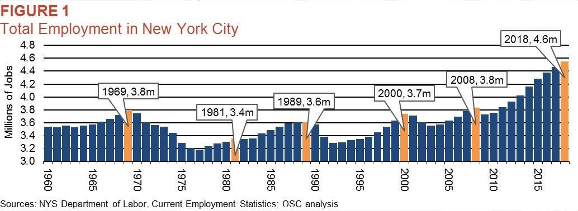
NYC total employment has grown steadily since 2009, and is 800,000 above previous peak

Slide 20
NYC’s significant sectoral job shifts since 1980
Manufacturing’s share fell from 30% in 1950 to 16% in 1980, then continued falling to 5% by 2000 and < 2% today.
Finance and insurance employ. rose in 1980s, and while it’s added some jobs since 2010, it’s share has dropped from 12% 1990 to 8%.
Local gov’t empl. (bulk of all gov’t), slightly higher in 2018 than in 1990, but share of all jobs declined from 13% in 1990 to < 11%.
Sectors below accounted for nearly all of 1 million 1990-2018 gain
Steady growth since 1980 in professional services (law, accounting, management consulting, advertising); with share rising from 7 to 9%.
Substantial growth in priv. education, health care and social assistance; but unique drivers. Combined +520K with share rising from 14% in 1990 to 22%.
Low-wage leisure & hospitality grew the fastest, doubling employment (+245K) from 1990 to 2018 (share rose 6-10%.)

Slide 21
Grouping
21 detailed occupations into four wage tiers
High-wage managers and professionals: executives, managers, doctors, lawyers, engineers & computer scientists.
Middle-wage other professional and technical: teachers, nurses & other health assessment & treatment, financial & ins. sales and sale supervisors, police & fire fighters.
Middle-wage blue collar: machine operators, precision production, construction trades, drivers, and laborers.
Low-wage service: admin. support, food prep., sales, clerks & cashiers, private household & personal service, building service, nursing & health aides.

Slide 22
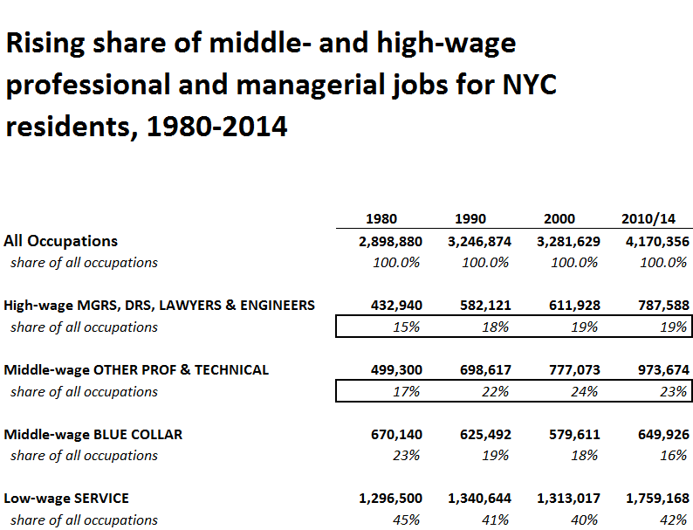

Slide 23
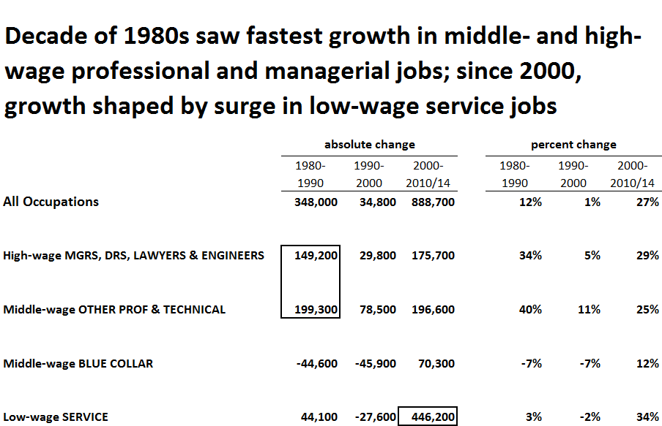

Slide 24
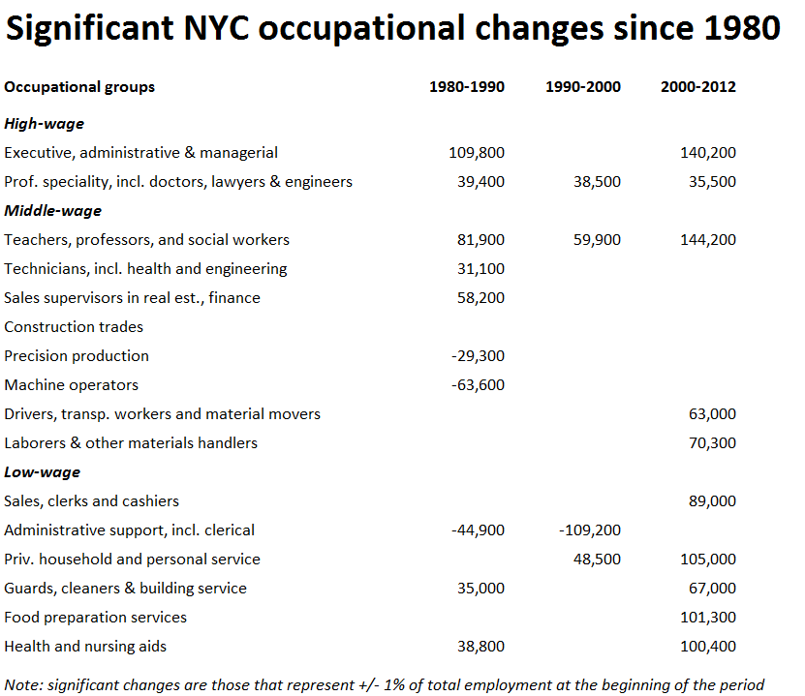

Slide 25
Transformation of work in an era of polarization
Consolidation within commercial banking; financialization and soaring compensation within securities sector—NYC the command center
Global professional services
Corporate downsizing, decline middle management and admin—non-core functions contracted out
Long-term decline in manufacturing, exacerbated by real estate pressures
Growth in health care and private education
Gov’t contracting fuels doubling in social assistance
Growth in leisure and hospitality (tourism)
Deteriorating quality of many blue & white collar jobs: reduced pay, benefits and rise in non-standard work arrangements and the “gig economy”

Slide 26
Relate economic changes to policy changes post-1980
Financial deregulation
Globalization, increased foreign investment, not regulating trade
Letting barriers to unionization remain
“Policy drift” in not responding to “fissuring” of the workplace
Allowing the minimum wage to falter
Fostering economic competition among states

Slide 27
Local policy-influenced real estate development (both commercial and residential) evolved in a way that favored particular forms of economic change
Local real estate industry long wielded considerable influence in City (and State) land use choices involving re-zoning and mega-development projects. Choices since 1960s favored higher-valued commercial office development at expense of manufacturing.
Post-fiscal crisis economic development paradigm added greater reliance on property tax breaks for both office and residential projects.
It also allowed private developers to reap all of the resulting value creation. Local government not able to channel any of the created value for public purposes or even to fund infrastructure.

Slide 28
How did these changes in economic structure affect wages and incomes?
One broad measure is the trend in inflation-adjusted median family income.
Since NYC undergoing significant transformation in racial/ethnic composition, look at by race/ethnicity. [NYC also experiencing significant influx of immigrants across the major racial/ethnic categories but nativity is not separately analyzed here.]
One caveat: because of dramatic employment and population decline in the 1970s (both leading up to and after the 1975 fiscal crisis), 1980 income values (technically 1979 incomes) were unusually low, partially accounting for the sizable income gains reported for the 1980s.

Slide 29
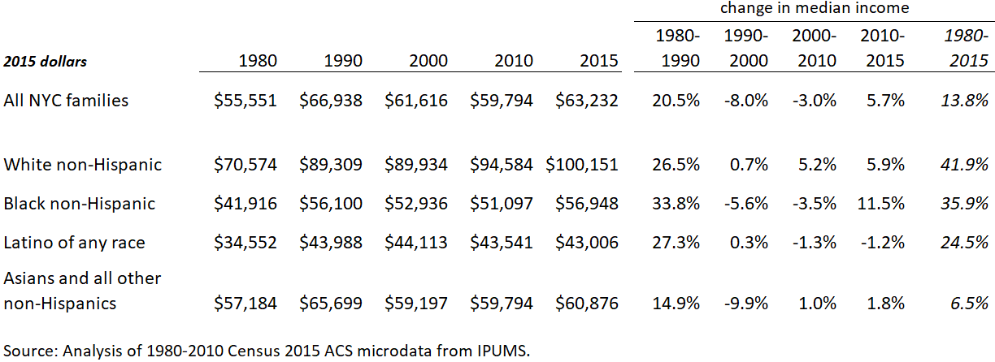
Median family incomes rose across the board in 1980s, declined for families of color in 1990s-2000s, recent gains for blacks

Slide 30
Blacks and Latinos see gains in 1980s following 1970s white flight

Slide 31
Following income declines in 1990s and 2000s, black families have seen gains in this decade (Latinos also since 2015)

Slide 32
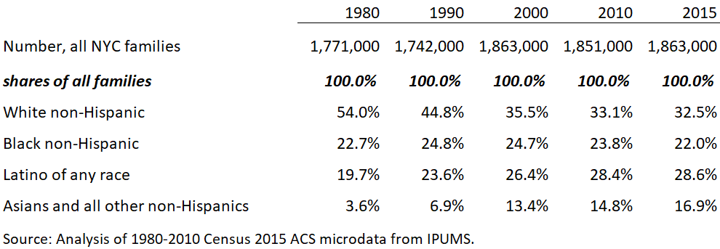
Rise in Latino and Asian shares of NYC population; decline, then flattening of white non-Hispanic share; stable black share
(rising immigrant shares within each not shown)

Slide 33
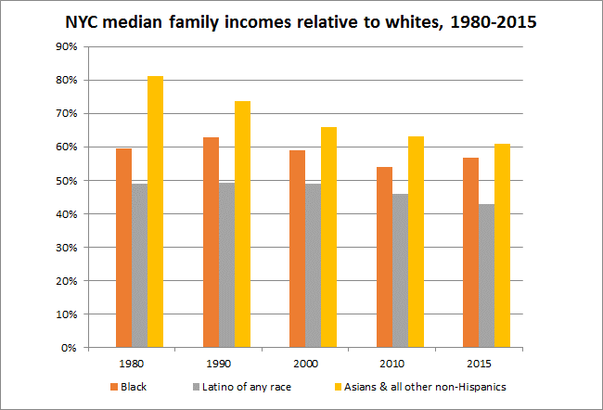

Slide 34
4. Current expansion’s dual character—wage and income gains, but persistent economic insecurity

Slide 35
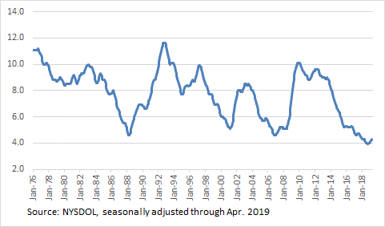
NYC unemployment rate lowest in at least 40 years

Slide 36
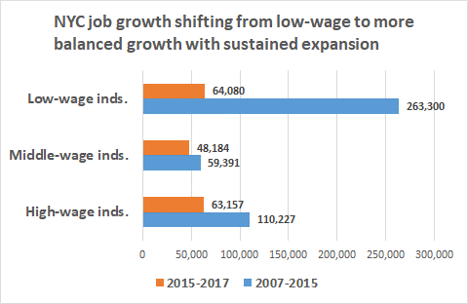

Slide 37
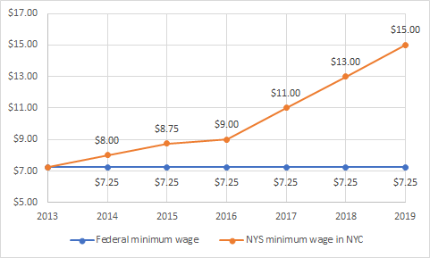
NYS policy to raise minimum wage above federal level—
> 2X in 6 years

Slide 38
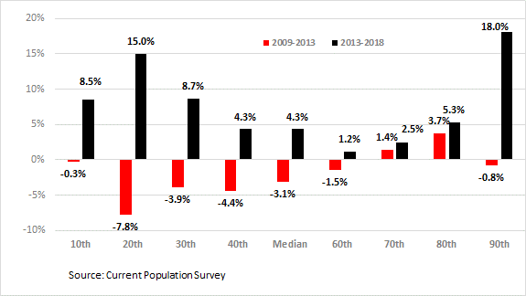
Strong real hourly wage gains for low-income NYC workers since 2013, largely due to minimum wage hikes

Slide 39
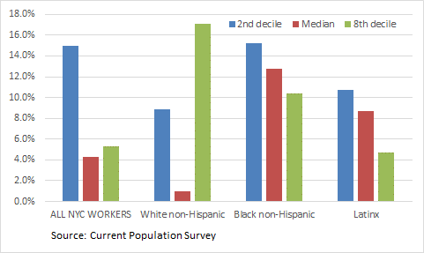
Real wage gains for NYC low- and median-wage Black and Latinx workers, 2013-2018

Slide 40
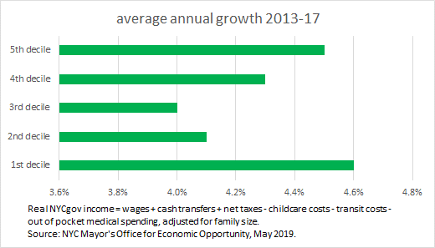
Significant real gains for low- and moderate-income NYC families, 2013-2017

Slide 41
Despite indicators of strong economic performance in recent years, also signs of considerable economic insecurity
For example, according to the Columbia Population Research Center, 23% of NYC residents had incomes < poverty in 2016, but 47% experienced poverty for at least one spell over a 3-year period.
The Community Service Society reports that 55% of low-income families and 38% of moderate income families (200-400% FPL) said housing affordability was a serious or very serious problem in 2018.
40% of NYC households lack adequate income to support a bare-bones family budget; 84% of such households have 1+ workers, according to 2018 Self-Sufficiency report by Univ. of Washington.

Slide 42
Many worker benefits have been eroded
Only 33% of workers in NYC participated in an employer-sponsored retirement plan in 2016, down from about 42% in 2000. (Ghilarducci)
While the City requires 5 paid sick days a year, over 500,000 NYC workers have no paid time off (the Mayor has proposed requiring employers with 5+ workers to provide 10 annual paid leave days.)
On the other hand, NYS enacted paid family leave policy for private employers in 2016 (by 2021, 2/3 of employee’s average wages for 12 weeks.)

Slide 43
5. How significant is the “gig economy” in NYC?

Slide 44
How significant is the “gig economy” in NYC?
Challenging data question because of limitations of survey and administrative (tax) data—divergent patterns
Survey data (CPS, ACS) show little/no increase in share of workforce self-employed, but non-employer (independent contractors) data show large increase
NYC: self-employed uninc. + 3% 2007-2016; employed +11%; but non-employer + 17%
Katherine Abraham defines “gig workers” as ICs + day laborers + online platform workers
Online platform workers roughly 3-4% (150-200K) of nearly 5 million NYC workers (2018).
NYC likely has > national average share of platform wokrers due to large size of app-dispatch (Uber, Lyft)

Slide 45
But aggregate economic importance of independent contract work not growing in NYC
Nonemployer net receipts (NNRs) relative to total earnings (QCEW wages + NNRs) 12.4% in 2016 vs 11.4% in 2007.
But significant industry shifts, with IC work rising in importance in taxis, movie production, and personal services; but declining in construction and securities industries.
NNRs share of total earnings 10% + in construction, wholesale trade, couriers & messengers, and social assistance
But NNRs share of earnings > 50% in taxis, real estate, and personal services; and about 1/3 in performing arts and repair & maintenance services

Slide 46
NYC TLC local regulation to address substandard pay and economic inefficiency
1st minimum pay standard for app-dispatched urban car services
Affects the largest segment of the online platform “gig economy”
Regulates a business model that inefficiently utilized workers and their capital (and relieves congestion)

Slide 47

Pay standard impacts 1st three months
TLC reports driver pay rose $150 million
Fares after discounts not much changed
Halt to on-boarding new drivers
Coupled with cap on new vehicles:
# of trips continues to rise
Wait times haven’t increased
Attrition declines slightly

Slide 48
6. What can be done locally to address income inequality?

Slide 49
Local policy levers (many depend on state authority)
Labor regulations
Budget and tax policies
Land use & economic development
Education (early childhood, K-12, higher ed)
Housing
Social inclusion (e.g., policing & criminal justice, integration, governance)

Slide 50
NYC local efforts to regulate labor practices
Paid sick days
Paid family leave
Proposed 10 days paid vacation time
“Freelance” isn’t free act requiring written agreements
Regulating scheduling practices in fast food and retail
Curbing wage theft, etc.
Regulating earnings of 85,000 independent contractor FHV drivers

Slide 52
Mayor and Speaker appointed Advisory Commission on Property Tax Reform
Multiple features causing widely varying effective property tax rates
Assessment caps created disparities by neighborhood
Overdue reforms needed in economic development and charitable tax exemptions
Significant nonresident ownership of luxury residential real estate distorting housing market
Albany action needed for most changes

Slide 53
Real estate regulation a powerful lever
With strong economy and declining crime, NYC attractive to many in-migrants and businesses → rising real estate values generally, adding to wealth very unevenly
But City has re-zoned scores of neighborhoods, including Hudson Yards, Brooklyn waterfront, and many former industrial areas → creating tremendous price appreciation and billions in value for private developers (plus tax code heavily favors real estate investors)
NYC needs effective ways to capture some of this value creation to support infrastructure renewal
NYC needs more effective ways to spur affordable housing development without inducing excessive luxury development

Slide 54
Thank you.
James Parrott
Center for New York City Affairs
The New School
ParrottJ@newschool.edu

