Slide 1
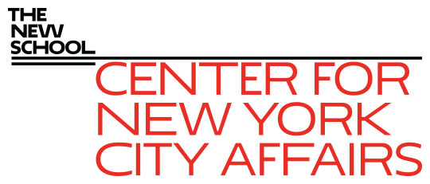
The Road to and from Salary Parity in NYC: Collective Bargaining and Nonprofits in Early Childhood Education March 12, 2020 James A. Parrott Local Government Lab: A Forum for NYS Researchers, Practitioners, and Policymakers Rockefeller Institute of Government
James A. Parrott, PhD
Director of Economic and Fiscal Policies
Center for New York City Affairs
New School University
JamesParrott@newschool.edu

Slide 2
The Center for New York City Affairs at The New School is an applied policy research organization that offers solutions to the most pressing social and economic challenges faced by New York communities. The Center conducts in-depth, timely research that informs public policy.
www.centernyc.org

Slide 3
Major Commitment to achieve starting pay salary parity in Early Childhood Education
Reached through collective bargaining July 2019 to raise pay for certified teachers in community-based organizations (CBOs) 30-40% by Oct. 2021.
First large-scale national example achieving semblance of salary parity between public schools and nonprofit-based ECE.
Nationally, 5 of every 6 ECE educators are not in public schools, many in nonprofits.
Pay disparities between public schools and nonprofits must be addressed with the expansion of Universal Pre-Kindergarten (UPK).
Also lessons for the broader nonprofit sector providing publicly-funded human services.
Connections to collective bargaining.

Slide 4
Road to salary parity … (not just 2019)
Push for Pre-K to make it part of public education system (UPK)
Extensive system of nonprofits providing human services, including ECE in subsidized centers, Head Start and others.
Historic pay disparities between nonprofits and public sector.
Prior NYC admin. invested little in nonprofits post-2008.
Didn’t negotiate with ECE union for nonprofit workers.
Early Learn in 2011 further disrupted ECE sector.
Transition to have Dept. of Education assume ECE responsibility.

Slide 5
Road from salary parity … 3 big challenges
Comprehensive salary parity (length of school year, longevity, benefits)
Enhanced career ladder—to more actively build pipeline of lead and certified teachers from current assistant teachers who are predominantly women of color
Increase family child care investments—home-based family child care providers not covered by salary parity agreement

Slide 6
Public policy dynamics in the nyc ece salary parity case
Complicated context with multiple stakeholders
Active Campaign for Children comprised of leading providers
Enlightened and ambitious public officials pre-disposed on the issue, but needed to be pushed
Campaign secured City Council support for funding as part of FY 2020 budget negotiations
Powerful union became involved through union merger of AFSCME DC 37 and DC 1707

Slide 7
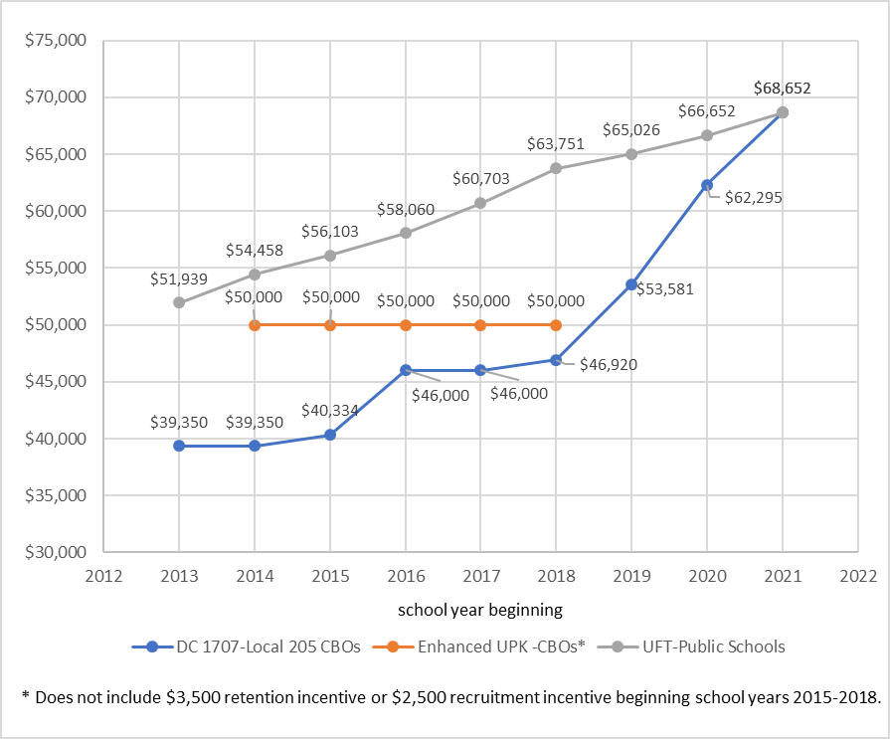
Starting pay levels, certified teachers w/ M.A.

Slide 8
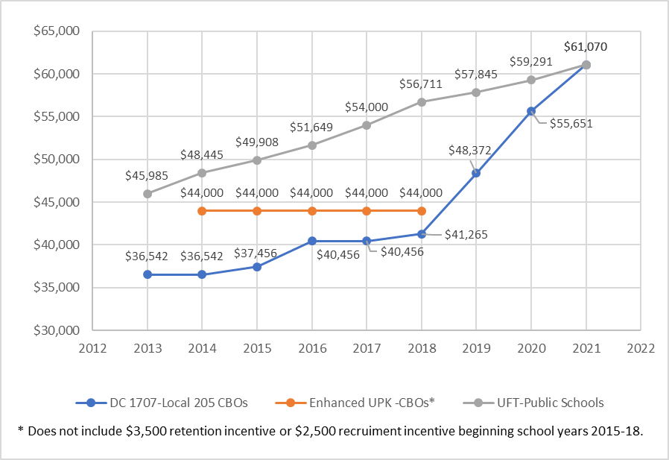
Starting pay levels, certified teachers w/ B.A.

Slide 9
Ece salary parity—2019 timeline
Campaign for Children stepped up year before
DCCNY report estimating cost of salary parity—Apr./May
City Council makes high priority in FY20 budget—Apr.
DC 1707-Local 205 contract talks re-opened—May
DC 37 & DC 1707 merge—June
Council-Mayor budget agreement—June
Salary parity agreement through 1707 contract—July
Formal announcement to extend sector-wide—Nov.

Slide 10
What’s next?
Local 205 contract expires Fall 2022—same time as UFT contract
Important for leadership of sector to stay unified and coordinate advocacy
Only about half of ECE sector is currently unionized—DC 37 seeks to expand organizing
Gains can be made on health and pension benefits if union
Opportunity with 2021 City elections to advance agenda for increased 0-3 investments

Slide 11
These analyses might also be of interest
New York State’s Historic Disinvestment in Human Services since the Great Recession: The Impact in NYC and Around the State March 2019, by James Parrott and Angela Butel, Center for NYC Affairs
http://www.centernyc.org/ny-state-historic-disinvestment
Time for a Real Look at How the New York State Workers’ Compensation System Treats Workers Feb. 2020, by James Parrott and Nicholas Martin, Center for NYC Affairs
http://www.centernyc.org/real-look-nys-workers-comp
New York City’s $15 Minimum Wage and Restaurant Employment and Earnings July 2019, by Lina Moe, James Parrott and Yannet Lathrop, Center for NYC Affairs and the National Employment Law Project
http://www.centernyc.org/new-york-citys-15-minimum-wage
The Magnitude of Low-Paid Gig and Independent Contract Work in NYS Feb. 2020, by Lina Moe, James Parrott and Jason Rochford.
http://www.centernyc.org/the-magnitude-of-low-paid-gig-and-independent-contract-work-in-new-york-state

Slide 12
Thank you. James Parrott Center for New York City Affairs The New School JamesParrott@newschool.edu

