Slide 1
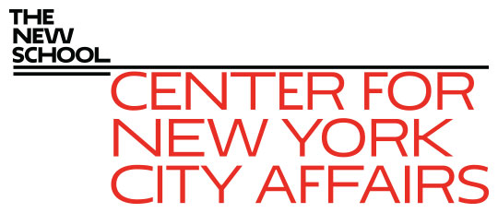
The Covid-19 winter is fast approaching James A. Parrott, PhD Center for New York City Affairs at The New School JamesParrott@newschool.edu www.centernyc.org Manhattan Chamber of Commerce December 1, 2020 Funding support provided by Robin Hood Foundation, JPMorgan Chase Foundation, New York City Workforce Development Fund, New York Community Trust, 21st Century ILGWU Heritage Fund, and Consortium for Worker Education
James A. Parrott, PhD
Director of Economic and Fiscal Policies
Center for New York City Affairs
New School University
JamesParrott@newschool.edu

Slide 2
Economic Update: More precarious NYC economy than any time since the 1970s economic/fiscal crisis
Covid-19 economy job losses not like a recession. Lop-sided impact hitting hardest at low-paying services; high-paying inds. spared.
Altogether, 1.2 million NYC residents (1/3 of total workforce) receiving unemploy. benefits.
Disproportionate impact on persons of color, young adults, immigrants, entry-level workers.
Small, locally-owned businesses in greater jeopardy than ever.

Slide 3
In addition to enormous job losses, broader economic risks to NYC
Covid economy not only hitting certain industries hard and jeopardizing business survival,
Poses severe challenge to how NYC functions—threatens arts, tourism, Manh. office-using econ., real estate & NYC tax base.
We risk losing many of the gains achieved in recent years with low unemployment, strong job growth, and historic wage gains.

Slide 4
Since Feb., total jobs in NYC declined more and have rebounded less than for the nation overall—NYC jobs still down 12% vs. 5% for U.S.

Slide 5
2nd wave of Covid cases greater in other large cities and the U.S. (about 50 as of Nov. 27) than in NYC

Slide 6
NYC metro small business revenue still down > 40% vs. Feb. (and declining); trailing other large metro areas

Slide 7
Leisure and Hospitality SME revenues were down nearly 80% in NYC metro and down 60% for U.S. as of mid-November

Slide 8
The Covid-19 crisis economy
3 groups of industries
Essential: health care, food, public safety and services
Face-to-face: restaurants, retail, arts, transportation, construction, local services
Remote: finance and real estate; profession services; higher education; information
=> A new strain of inequality hitting hardest at low-wage workers, many of color.

Slide 9
NYC industries with greatest job losses vs. the U.S. are all face-to-face industries
The reason NYC’s job losses are twice the national average is largely rooted in 5 industries, and related to arts, tourism and office jobs:
Arts & entertainment
Hotels & restaurants
Transportation
Admin. srvcs (temp agencies & bldg. srvcs.)
Retail

Slide 10
In the Hotel & Restaurant sector so critical for Manhattan, October jobs were still 38% below Feb., vs. 17% for the U.S.

Slide 11
Total NYC Oct. Retail employment was 9% below Feb., but Clothing Store jobs (2/3 of which are in Manhattan) were still down 38%

Slide 12
In Arts, Recreation and Entertainment, there has been no recovery in NYC, but U.S. has recovered half of jobs lost

Slide 13
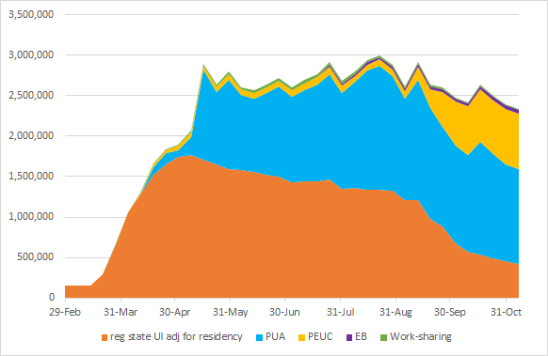
2.3 million NYS residents receiving unemployment insurance as of 1st wk. of November; PUA ends Dec. 27

Slide 14
CNYCA Covid-19 Economic Recovery Project
Analyze nature and magnitude of job displacements to inform NYC & NYS policy (UI , workers comp, small business aid, tax & budget issues)
Inform workforce development organizations regarding return to work, health & safety, training needs, and demand-side policies

Slide 15
The road from here?
No alternative to massive Federal economic support:
For workers and families
To keep small businesses alive
The last portions of Federal aid enacted in March will run out at the end of Dec,
To maintain public services and re-build our health care system
A vaccine won’t bring the economy back--ultimately, we’ll need Fed. investments in mass transit, infrastructure and the caring economy.
The lop-sided pandemic economy calls for a commitment to burden-sharing from large corporations and the super-wealthy.

