Slide 1
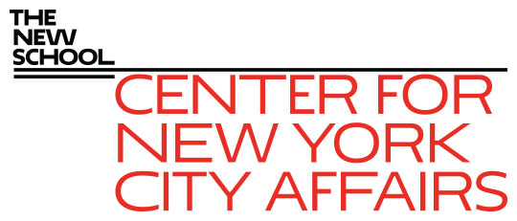
The labor market implications of the Covid-19 impact on NYC’s hospitality industry James A. Parrott Center for New York City Affairs at The New School JamesParrott@newschool.edu www.centernyc.org WPTI Employer Symposium Series—Hospitality, November 17, 2020 Funding support provided by Robin Hood Foundation, JPMorgan Chase Foundation, New York City Workforce Development Fund, New York Community Trust, 21st Century ILGWU Heritage Fund, and Consortium for Worker Education
James A. Parrott, PhD
Director of Economic and Fiscal Policies
Center for New York City Affairs
New School University
JamesParrott@newschool.edu

Slide 2
Overview
Covid’s economic impact in NYC: jobs, small business, vs. U.S.
Covid impact threatens historic job and wage gains in recent years benefitting a large NYC entry-level workforce in hospitality
Labor market implications of these trends given NYC hospitality’s demographic and occupational profile

Slide 3
First, a few fast facts on NYC hospitality
370,000 NYC Hospitality workers (pre-pandemic), up by 133,000 (56%) from 2009-2019
10% of resident NYC payroll workers, but 15% of entry level jobs
Nearly 25,000 businesses: 18,000 Restaurants; 2,500 Coffee Shops; 1,500 Bars; 950 Hotels; and 1,300 food serv. contractors, caterers, & food trucks.
Great diversity of business types.
Impressive average wage gains in unionized Manhattan hotels, and sizable wage gains in restaurants, largely due to minimum wage.

Slide 4
Economic Update: More precarious NYC economy than any time since the 1970s economic/fiscal crisis
Covid-19 job losses not like a recession. Lop-sided impact hitting hardest at low-paying services; high-paying industries spared.
Altogether, 1.2-1.3 million NYC residents (1/3 of total workforce) receiving unemploy. benefits.
Disproportionate impact on persons of color, young adults, immigrants, entry-level workers.
Small, locally-owned businesses in greater jeopardy than ever.

Slide 5
How has the Hospitality sector fared?
Tourism (incl. busn. travel) is the main driver of the hospitality sector and tourism has been flattened by Covid-19.
Hotel occupancy minimal, many haven’t re-opened.
Full-service restaurants have lost considerable business due to Covid restrictions.
It could take 2-3 years for tourism to rebound fully, and possibly that long for restaurants.
This is a tremendous setback to NYC low-wage workers—hospitality-related jobs grew substantially in recent years with wages rising steadily (more than in most sectors).

Slide 6
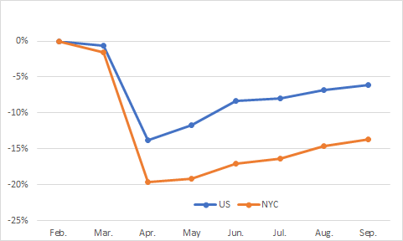
Since Feb., total jobs in NYC declined more and have rebounded less than for the nation overall—NYC jobs still down 14% vs. 6% for U.S.

Slide 7
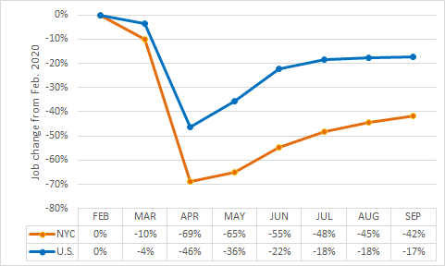
In Hospitality, NYC’s job decline has been much steeper and the rebound slower, with the September job level still 42% below February vs. 17% for the U.S.

Slide 8
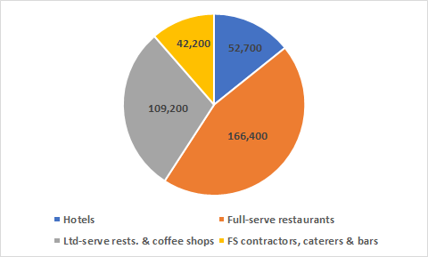
Pre-pandemic, Hotels accounted for 14% of Hospitality jobs; Full-service restaurants were 45%, Limited-service 30% and Food Service contractors, caterers and bars 11%

Slide 9
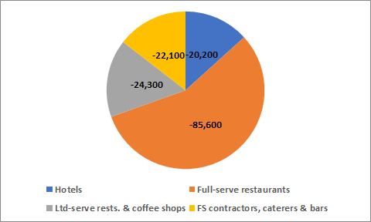
Pandemic job losses mostly in Full-serve (56%), with the 3 other sectors accounting for 15% each

Slide 10
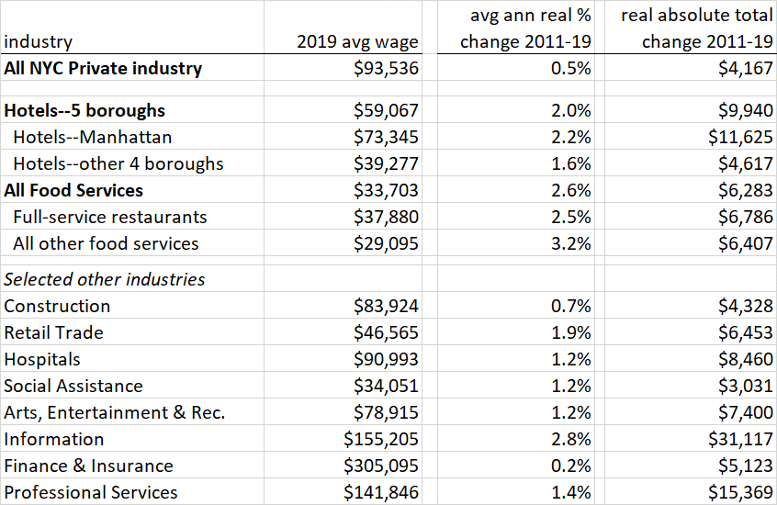
NYC Hospitality workers had larger wage gains 2011-19 than most private sector workers, although avg. wages generally lower except for Manhattan hotel workers (many are union)

Slide 11
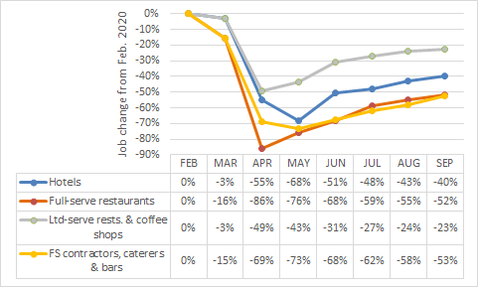
Jobs in Full-serve restaurants, contractors, caterers and bars are still down more than half, hotels by 42%, and limited-serve and coffee shops down by 23%

Slide 12
Demographics of NYC Hospitality workers compared to all NYC wage workers
All Hospitality workers are:
More likely to be workers of color (80% vs. 66%)
More likely to be immigrant (61% vs. 48%)
Less likely to have a coll. Deg. (23% vs. 48%)
Hotel workers are :
More likely to be female
Older (55% 40+ vs. 47%)
Slightly more likely to be full-time
Rest. and other food service workers are:
More likely to be male
Young, with twice the share of 18-24 workers and half the share of 55+ workers
More likely to receive food stamps (24% vs. 16%)

Slide 13
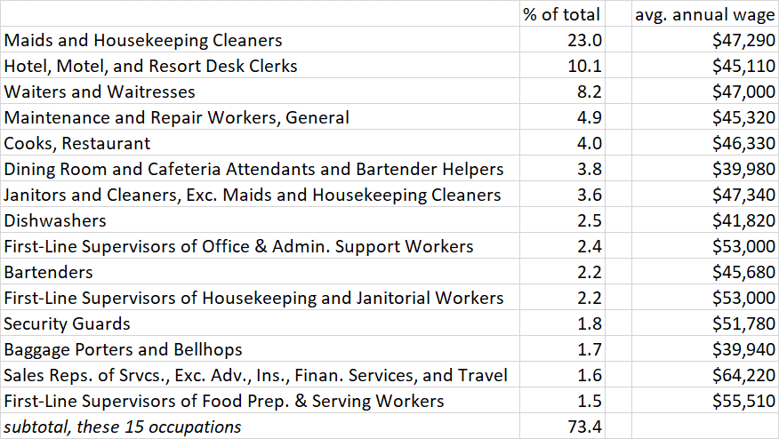
15 leading occupations, NY Hotel industry

Slide 14
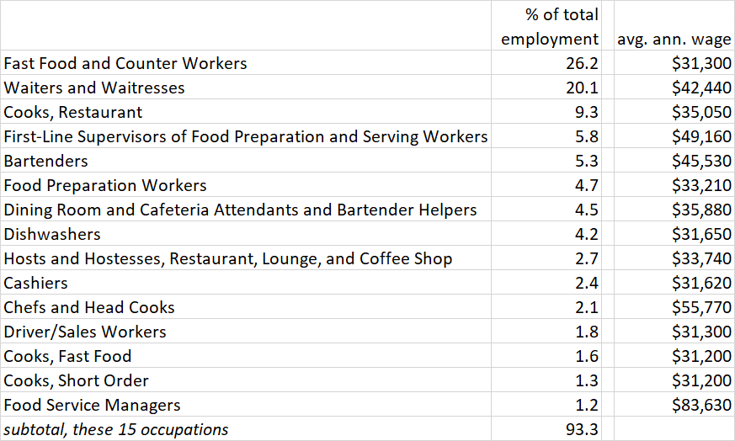
15 leading occupations, NYC Food Services

Slide 15
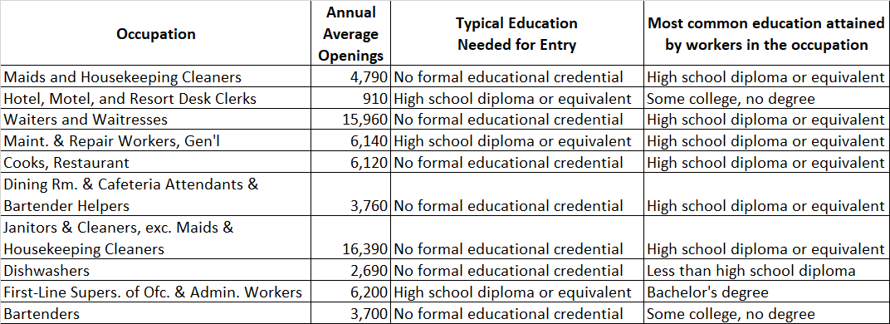
Annual openings and education requirements for largest NYC Hotel occupations

Slide 16
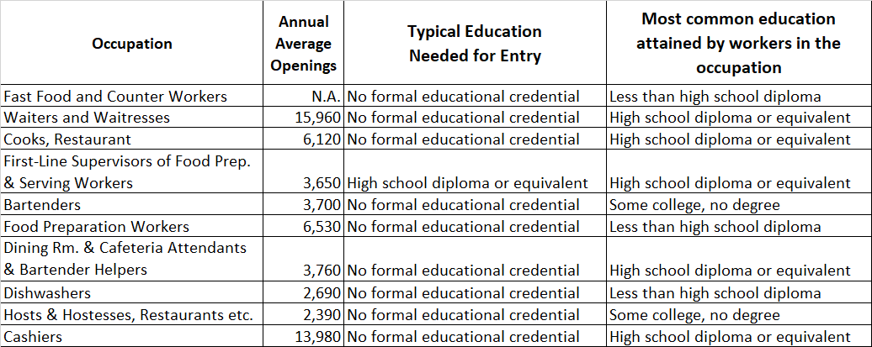
Annual openings and education requirements for largest NYC Food Service occupations

Slide 17
Covid-19 impacts on hospitality are a severe blow to NYC’s low-wage workers
The limited-service and coffee shop part of the sector has been less affected, but these are the lowest-paid jobs in hospitality.
More “ghost kitchens” are opening but those generally don’t generate many good jobs.
The best hospitality jobs in NYC are in predominantly Manhattan union hotels that have been hit hard, and that will be slow to recover. These workers have the highest wages, solid health benefits, and protections for recall rights and health and safety.
Most full-service restaurants that are the largest hospitality employer are small, locally-owned businesses that are teetering on the brink.
Restaurant delivery busn. not very profitable, doesn’t employ many people, with delivery workers working for apps for low pay.

Slide 18
Labor market implications
Workers concerned about safe return to work, rely on employers to provide a safe workplace and for customers to socially-distance.
State Labor Department needs to clarify circumstances under which a worker can refuse to return to work if the workplace is not considered safe (and not lose UI eligibility.)
NYS also needs to fix the problem with its “partial unemployment” provision that penalizes workers who return to work on a part-time basis.
Some businesses taking advantage of workers’ weak bargaining position to degrade jobs by making them independent contractors rather than employees.

Slide 19
The road from here?
Unemployed and small businesses (and state and local governments, MTA, etc.) need additional Federal economic support.
Need state and federal policy changes to improve social & worker safety net and work supports, particularly for childcare.
=> Our hospitality report will be released in the coming weeks.
Pressure needs to build on federal policy-makers to respond—600,000 NYC residents will lose UI benefits and the national eviction moratorium expires at the end of the year.
Ultimately, we’ll need national policy responses to the jobs hole Covid-19 has put us in, and to restore sectors like tourism and arts and entertainment.

Slide 20
Thank you. James Parrott Center for New York City Affairs The New School ParrottJ@newschool.edu

