Slide 1
The labor market implications of the Covid-19 impact on NYC’s retail industry James A. Parrott Center for New York City Affairs at The New School JamesParrott@newschool.edu www.centernyc.org WPTI Employer Symposium Series—Retail October 20, 2020 Funding support provided by Robin Hood Foundation, JPMorgan Chase Foundation, New York City Workforce Development Fund, New York Community Trust, 21st Century ILGWU Heritage Fund, and Consortium for Worker Education
James A. Parrott, PhD
Director of Economic and Fiscal Policies
Center for New York City Affairs
New School University
JamesParrott@newschool.edu

Slide 2
Overview
Covid’s economic impact in NYC: jobs, small business, vs. U.S.
Uneven effects in retail intensify prior trends regarding e-commerce and technology
Labor market implications of these trends given NYC retail’s demographic and occupational profile

Slide 3
First, a few fast facts on NYC retail
340,000 NYC retail workers (pre-pandemic)
1 in every 10 NYC payroll (wage) jobs
Higher share, 1 in 7 entry level jobs
32,000 retail establishments, mix of chain stores and locally-owned small retail, with growing e-commerce
Pre-pandemic retail employment trend flat in NYC, but shift within segments, and growth in boroughs outside of Manhattan (but Manhattan still has 45% of all NYC retail jobs)
NYC has a smaller share of retail jobs relative to all private jobs (8.8%) compared to the national average (12.3%)

Slide 4
Economic Update: More precarious NYC economy than any time since the 1970s economic/fiscal crisis
Covid-19 economy job losses not like a recession. Lop-sided impact hitting hardest at low-paying services; high-paying inds. spared.
Altogether, 1.2-1.3 million NYC residents (1/3 of total workforce) receiving unemploy. benefits.
Disproportionate impact on persons of color, young adults, immigrants, entry-level workers.
Small, locally-owned businesses in greater jeopardy than ever.

Slide 5
How has the retail sector fared?
Overall U.S. retail sales have revived, but significant shifts.
Great unevenness by segment, and especially large vs. small.
Amazon !!!
Ability to move on-line
Access to PPP
Supply chain problems
Months of depressed sales off by 20-40% or more; high commercial rents a fixed cost.
Century 21 bankruptcy but also bleak prospects for a quick recovery or appropriate gov’t aid—survival in question for thousands of small NYC businesses.

Slide 6
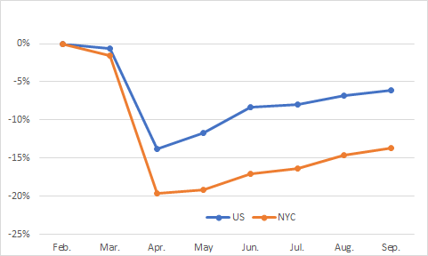
Since Feb., total jobs in NYC declined more and have rebounded less than for the nation overall—NYC jobs still down 14% vs. 6% for U.S.

Slide 7
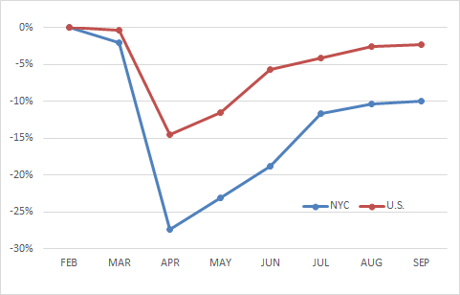
Same picture in retail, NYC total retail employment fell by 27% in April and back up in Sept. to 10% below Feb., while U.S. retail jobs now down only 2%

Slide 8
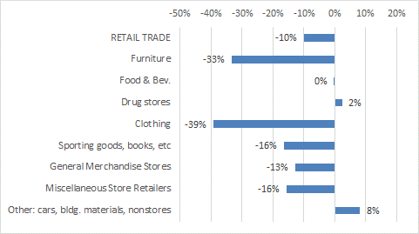
Unevenness in NYC retail sector employment—drug stores and “other” up, but clothing down (Feb.-Sept. 2020)

Slide 9
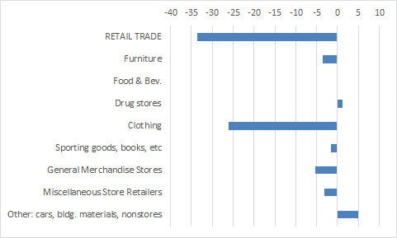
Overall, net retail NYC job decline of 34,000, ¾ in clothing stores; “other” (mainly e-commerce) up 5,000 jobs (Feb.-Sept. 2020)

Slide 10
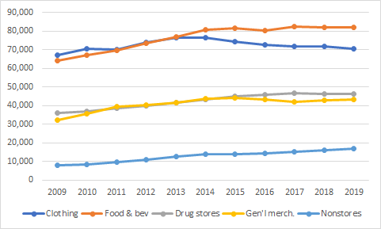
Recent pattern reflects pre-pandemic trends: clothing down, drug stores & nonstores up

Slide 11
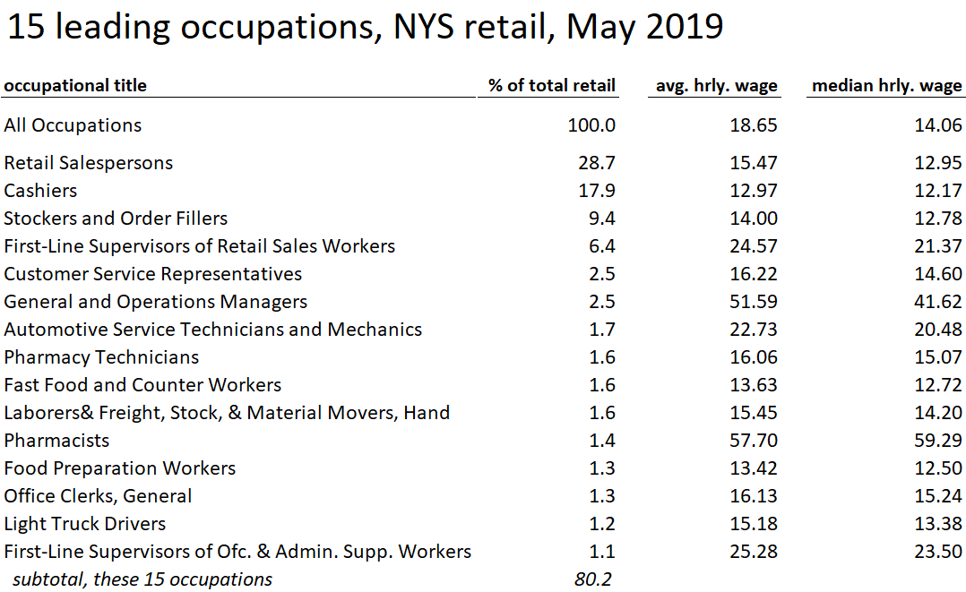

Slide 12
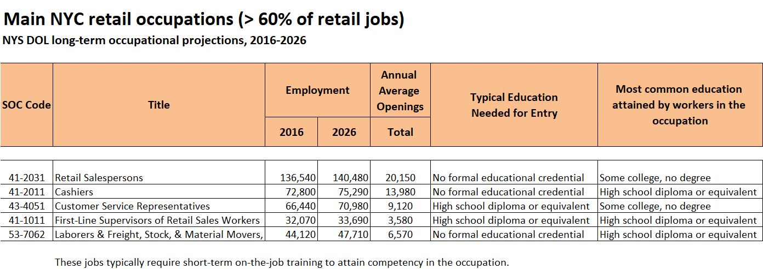

Slide 13
Demographics of NYC retail workers
48% female vs. 45% for all NYC private payroll (or wage) workers
69% persons of color vs. 61% for all NYC wage workers
Young adults are 20% of all retail workers vs. 10% for all NYC workers
22% of all NYC young workers work in retail
40% HS or LTHS vs. 32% for all workers
65% w/ earnings < $40K vs. 45% for all

Slide 14
Covid-19 sharply accelerated E-commerce trend
Nationally, e-commerce sales up 44% in Q2; nonstore retail sales up 24% Sept. over Sept. Pandemic accelerated online shift by 5 years according to IBM.
Etsy, the Brooklyn-based online marketplace, saw 2nd quarter sales jump 147% (including from the sale of 340 million masks).
Amazon eyes much greater NYC sales with another giant distribution center on Staten Island.
Also, U.S. retail sales shifted over past year w/ clothing and dept. store sales down, and grocery and motor vehicle sales both up about 11%.

Slide 15
Labor market implications
Continued E-commerce growth: tech positions and customer service needs
NYC tech ecosystem fosters E-commerce start-ups combining design and marketing
While brick and mortar stores may continue to shrink, high annual volume of replacement positions
Drugstores are expanding health clinics
More NYC distribution centers & delivery jobs

Slide 16
Workforce development implications
Hiring shifts more online, digital divide issues.
As usual in downturn, employers likely to increase skill requirements, but e-commerce generally requires greater technology competence.
Issues faced by many front-line workers with health and safety, paid leave, scheduling.
Challenges in making sure distribution and delivery jobs are safe and that they are good jobs.
Public policy need for improvements to NYS partial unemployment insurance.

Slide 17
The road from here?
Unemployed and small businesses (and state and local governments, MTA, etc.) need additional Federal economic support.
Need state and federal policy changes to improve social & worker safety net and work supports, particularly for childcare.
To “build back better” in retail, focus could be on assisting more young workers of color in getting into good paying e-commerce jobs, and on building more explicit career pathways within retail.
=> Our retail report will be released in early November

Slide 18
Thank you. James Parrott Center for New York City Affairs The New School ParrottJ@newschool.edu

