Slide 1
Update on the Covid-19 economic and job impact on New York City James A. Parrott Center for New York City Affairs JamesParrott@newschool.edu www.centernyc.org SBS Workforce1 Career Center team September 10, 2020 (Adapted from a presentation for the Sept. 9 Workforce Funders meeting)
James A. Parrott, PhD
Director of Economic and Fiscal Policies
Center for New York City Affairs
New School University
JamesParrott@newschool.edu

Slide 2
More precarious NYC economy than any time since the 1970s economic/fiscal crisis
April projections have been borne out about magnitude of job disruptions and concentrated impact on communities of color.
Recovery was never going to be easy, but pace of job rebound has slowed/possibly stalled.
New York City and State harder hit than rest of the country.
1.3-1.4 million NYC residents (1/3 of total workforce) receiving unemployment benefits.

Slide 3
The Covid-19 crisis economy
3 groups of industries
Essential: health care, food, public safety and services
Face-to-face: restaurants, retail, arts, transportation, construction, local services
Remote: finance and real estate; profession services; higher education; information
=> A new strain of inequality hitting hardest at low-wage workers, many of color.

Slide 5
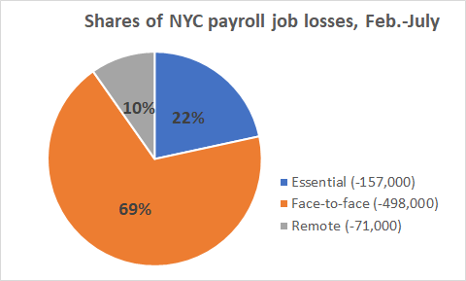
Note: self-employed and independent contractors have lost 500,000-600,000 jobs
not included in the payroll job numbers.

Slide 6
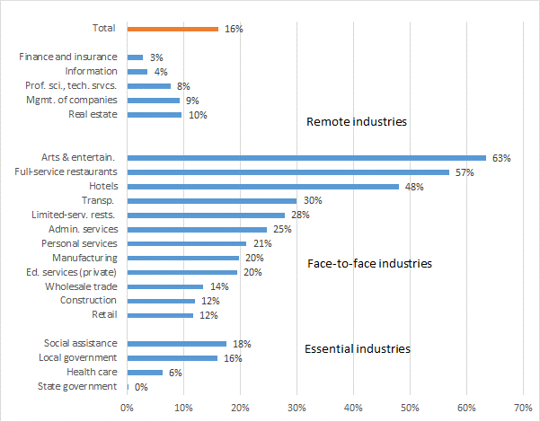
NYC payroll employment job losses, Feb.-July

Slide 7
Dislocated workers disproportionately persons of color, young, w/o a college degree, and immigrant

Slide 8
Where has there been hiring?
Delivery jobs
Food retail operations
Moving companies
Bicycle and auto dealers
PPE production
Where else?

Slide 9
NYS continuing weekly UI claims; NYC accounts for half.

Slide 10
Two measures of NYC unemployment, June 2020

Slide 11
The road from here?
Several sectors under severe pressure—led by restaurants, arts, social services and others.
No alternative to massive federal economic support:
For workers and families
To keep small businesses alive
Need policy solutions for residential & commercial rent burdens.
Need state policy changes to improve social & worker safety net.
To maintain public services and re-build our health care system

