Slide 1
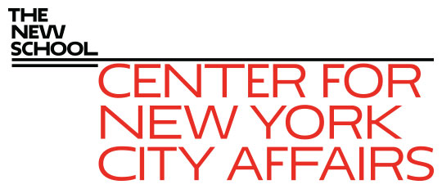
Local Policy Matters When It Comes to Inequality September 27, 2019 James A. Parrott Lindsay Fellows in Government Leadership and Practice CUNY Institute for State and Local Governance
James A. Parrott, PhD
Director of Economic and Fiscal Policies
Center for New York City Affairs
New School University
ParrottJ@newschool.edu

Slide 2
The Center for New York City Affairs at The New School is an applied policy research organization that offers solutions to the most pressing social and economic challenges faced by New York communities. The Center conducts in-depth, timely research that informs public policy.
www.centernyc.org

Slide 3
1. Income Inequality 101: Policy Matters 2. New York City as the Capital of Inequality: Roots and Trends 3. Going Local Since the Fiscal Crisis: Policy Action/Inaction Makes a Difference, Especially for Those at the Bottom
Overview

Slide 4
1. Income Inequality 101: Policy Matters

Slide 5
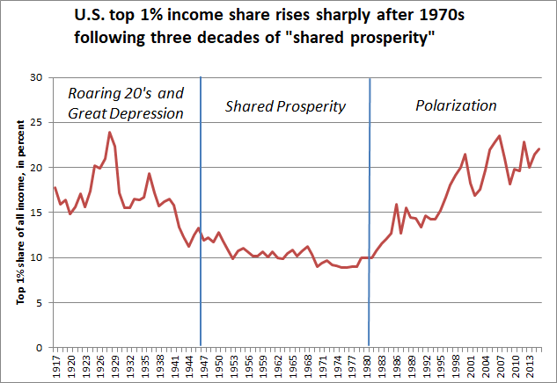

Slide 6
Income share of bottom 50% falls steadily after 1980
Source: Piketty, Saez and Zucman, Distributional National Accounts: Methods and Estimates for the
U.S., Data Appendix, Nov. 10, 2017.

Slide 7
2. New York City as the Capital of Inequality: Roots and Trends?

Slide 8
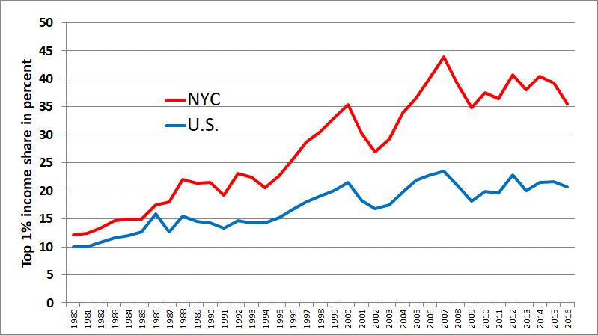
Income share of top 1% much greater in New York City than in the U.S.
1% share in NYC fell in 2015 due to capital gains decline, and in 2016 due to tax planning in anticipation of Trump tax cuts. Still, some slight improvement vs. U.S. trend.

Slide 9
NYC, Dallas and Boston share the top spot for greatest income inequality based on Gini coefficients among 25 largest cities, 2012-16

Slide 10
What accounts for NYC’s higher income concentration?
Large finance sector
Corporate HQ and professional services
Inherited and new wealth
Real estate

Slide 11
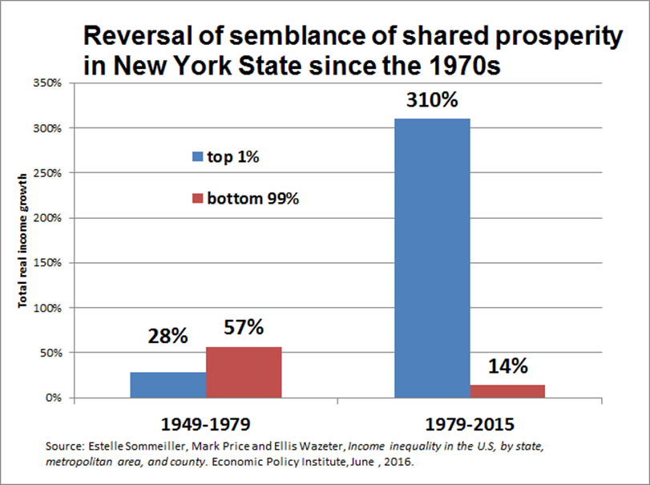

Slide 12
If NYC median family income had grown at the same pace as the increase in the city’s per capita gross city product, the 2014 level would have been about $97,000, about two-thirds higher than the 2014 actual.

Slide 13
3. Going Local Since the Fiscal Crisis: Policy Action/Inaction Makes a Difference, Especially for Those at the Bottom

Slide 14
Relate changes in the structure of NYC’s economy in the post-1980 era to key income metrics and policy choices
For the bottom 95%, wages are 93% of all income--how did sector and occupational changes affect wages.
Consider the policy developments (both action and inaction) that influenced particular forms of economic change.
Consider how policy choices might have affected key measures of income inequality.

Slide 15
Relate economic changes to policy changes post-1980
Financial deregulation
Globalization, increased foreign investment, not regulating trade
Letting barriers to unionization remain
“Policy drift” in not responding to “fissuring” of the workplace
Allowing the minimum wage to falter
Fostering economic competition among states

Slide 16
Median family incomes rose across the board in 1980s, declined for families of color in 1990s-2000s, recent gains for blacks

Slide 17
Blacks and Latinos see gains in 1980s following 1970s white flight

Slide 18
Following income declines in 1990s and 2000s, black families have seen gains in this decade (Latinos also since 2015)

Slide 19
Rise in Latino and Asian shares of NYC population; decline, then flattening of white non-Hispanic share; stable black share (rising immigrant shares within each not shown)

Slide 20
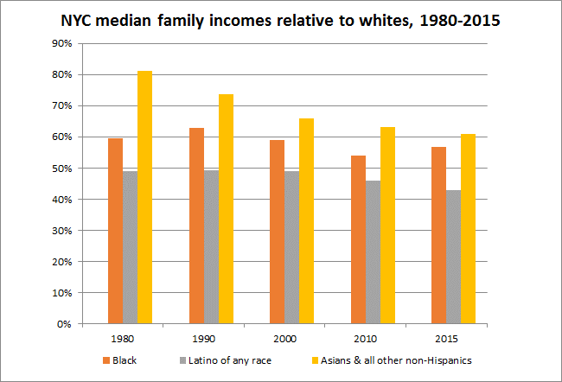

Slide 21
NYC unemployment rate lowest in at least 40 years

Slide 22
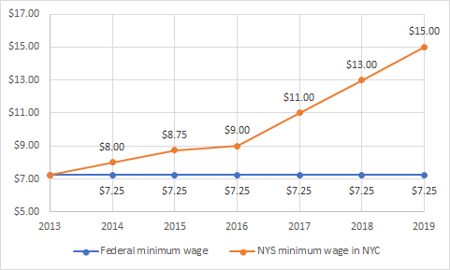
NYS policy to raise minimum wage above federal level— more than doubled in 6 years

Slide 23
Strong real hourly wage gains for low-income NYC workers since 2013, largely due to minimum wage hikes

Slide 24
Real wage gains for NYC low- and median-wage Black and Latinx workers, 2013-2018

Slide 25
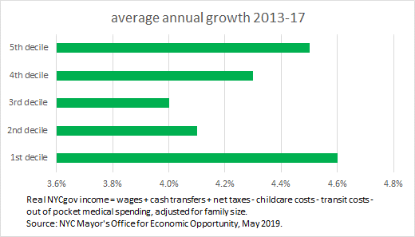
Significant real gains for low- and moderate-income NYC families, 2013-2017

Slide 26
Despite indicators of strong economic performance in recent years, also signs of considerable economic insecurity
For example, according to the Columbia Population Research Center, 23% of NYC residents had incomes < poverty in 2016, but 47% experienced poverty for at least one spell over a 3-year period.
The Community Service Society reports that 55% of low-income families and 38% of moderate income families (200-400% FPL) said housing affordability was a serious or very serious problem in 2018.
40% of NYC households lack adequate income to support a bare-bones family budget; 84% of such households have 1+ workers, according to 2018 Self-Sufficiency report by Univ. of Washington.

Slide 27
Many worker benefits have been eroded
Only 33% of workers in NYC participated in an employer-sponsored retirement plan in 2016, down from about 42% in 2000. (Ghilarducci)
While the City requires 5 paid sick days a year, over 500,000 NYC workers have no paid time off (the Mayor has proposed requiring employers with 5+ workers to provide 10 annual paid leave days.)
On the other hand, NYS enacted paid family leave policy for private employers in 2016 (by 2021, 2/3 of employee’s average wages for 12 weeks.)

Slide 28
How significant is the “gig economy” in NYC?
Commonality among many self-employed, gig workers & freelancers: independent contractors (some misclassified) who are not employees
Best available data suggest the total NYC earnings from IC about $50B, or 15% of total private payrolls.
Low-earning ICs get about 10% of that $50B. High-earners & those seeking supplemental pay receive most of it.
NYC has about 260,000 low-earning full-time ICs and another 200,000 part-time ICs in low-paying industries.
There are 170,000 high-earning incorporated self-employed, plus 290,000 full-or part-time ICs in high-paying industries.
Best data suggests about 100,000 online platform workers, roughly 2% of 5.1 million NYC workers.

Slide 29
Most NYC online platform workers are low-earning, but there are many more non-online low-earning ICs (370,000 vs. 90,000).
Of the approximately 100,000 on-line platform workers, most (80-90%) are FHV drivers, followed by delivery workers, then various personal services (e.g., dog-walking or house-cleaning), and design, editing and writing gigs.
But there are another 370,000 independent contractors whose work is not arranged through an app in low-earning industries and occupations who don’t have the usual employment rights. Included here are:
70,000 taxi and other drivers,
50,000 construction workers,
30,000 nail salon and beauty parlor workers,
25,000 janitors and security guards,
20,000 administrative service workers,
plus thousands more in restaurants, social services, and various personal care and other personal services.

Slide 30
NYC TLC local regulation to address substandard pay and economic inefficiency
1st minimum pay standard for app-dispatched urban car services
Affects the largest segment of the online platform “gig economy”
Regulates a business model that inefficiently utilized workers and their capital (and relieves congestion)

Slide 31
Pay standard impacts 1st three months
TLC reports driver pay rose $150 million
Fares after discounts not much changed
Halt to on-boarding new drivers
Coupled with cap on new vehicles:
# of trips continues to rise
Wait times haven’t increased
Attrition declines slightly

Slide 32
Local policy levers to address income inequality (many depend on state authority)
Labor regulations
Budget and tax policies
Land use & economic development
Education (early childhood, K-12, higher ed)
Housing
Social inclusion (e.g., policing & criminal justice, integration, governance)

Slide 33
NYC local efforts to regulate labor practices
Paid sick days
Paid family leave
Proposed 10 days paid vacation time
“Freelance” isn’t free act requiring written agreements
Regulating scheduling practices in fast food and retail
Curbing wage theft, etc.
Regulating earnings of 85,000 independent contractor FHV drivers

Slide 34
Mayor and Speaker appointed Advisory Commission on Property Tax Reform
Multiple features causing widely varying effective property tax rates
Assessment caps created disparities by neighborhood
Overdue reforms needed in economic development and charitable tax exemptions
Significant nonresident ownership of luxury residential real estate distorting housing market
Albany action needed for most changes

Slide 35
These analyses might also be of interest
New York State’s Historic Disinvestment in Human Services since the Great Recession: The Impact in New York City and Around the State March 2019, by James Parrott and Angela Butel, Center for NYC Affairs
http://www.centernyc.org/ny-state-historic-disinvestment
Time for a Real Look at How the New York State Workers’ Compensation System Treats Workers May 2019, by James Parrott and Nicholas Martin, Center for NYC Affairs
http://www.centernyc.org/real-look-nys-workers-comp
New York City’s $15 Minimum Wage and Restaurant Employment and Earnings July 2019, by Lina Moe, James Parrott and Yannet Lathrop, Center for NYC Affairs and the National Employment Law Project
http://www.centernyc.org/new-york-citys-15-minimum-wage

Slide 36
Thank you. James Parrott Center for New York City Affairs The New School ParrottJ@newschool.edu

